Slide 1
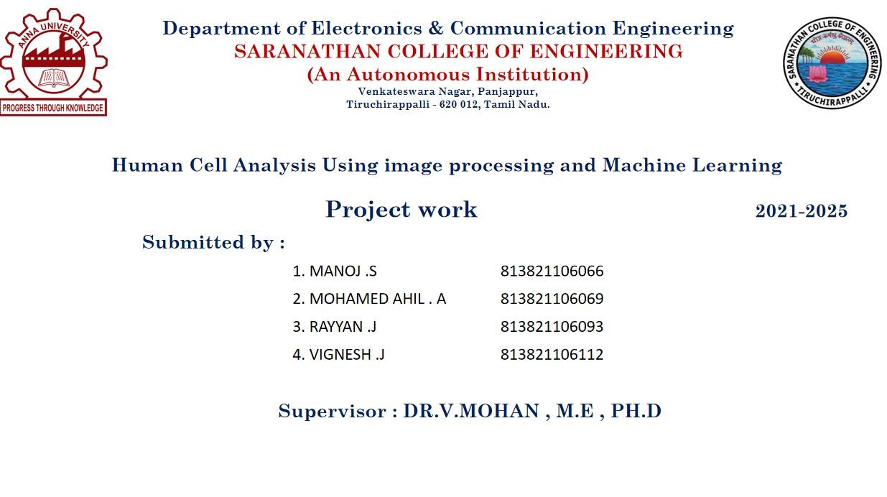

Slide 2


















































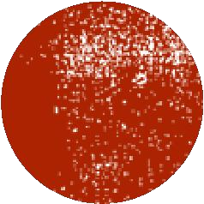


Slide 3
Outline
Project Objective: Develop a cutting-edge, automated human cell analysis system for faster and more accurate disease detection and treatment planning.
Integrated Deep Learning Approach:
U-Net for Segmentation: Precisely isolates cells from complex backgrounds.
RCNN for Classification: Accurately categorizes cells based on detailed morphological features.
Advanced Image Preprocessing: Enhances contrast and reduces noise, ensuring high-quality input for analysis.
Automated Workflow: Streamlines the entire analysis process, significantly reducing manual intervention and human error.
Clinical Impact: Empowers medical professionals with robust, reliable data for quicker, more informed diagnostic decisions.
Broad Applicability: Offers potential applications in pathology, biomedical research, and automated disease detection.

Slide 4
Introduction
This project automates human cell analysis for disease detection using deep learning. It preprocesses images, enhances contrast, and reduces noise. U-Net segments cells, and RCNN classifies them by morphology. By reducing manual effort, this approach improves accuracy and consistency, supporting faster, more reliable diagnostic decisions in medical practices.
Human cell analysis is vital for early disease detection and treatment planning. Traditional manual methods are laborious and error-prone. This project automates analysis by preprocessing images to enhance contrast and reduce noise, segmenting cells with U-Net, and classifying them via RCNN, resulting in faster, more consistent, and highly reliable diagnostics

Slide 5
Problem Statement
Problem :
Manual analysis of microscopic cell images is slow and error-prone due to issues like noise, low contrast, and ineffective traditional segmentation, leading to inconsistent cell classification and compromised diagnosis.
Solution :
Develop an automated pipeline that integrates advanced preprocessing (to enhance image quality), U-Net (for precise cell segmentation), and RCNN (for accurate cell classification), thereby reducing manual intervention and improving diagnostic reliability.

Slide 6
Objective
Image Preprocessing: Enhance microscopic cell images by reducing noise and increasing contrast for precise analysis.
Segmentation with U-Net: Isolate regions of interest by accurately separating cells from the background.
Cell Classification via RCNN: Categorize segmented cells based on their morphological traits.
Automated Pipeline Integration: Combine segmentation and classification to expedite analysis and minimize manual labor.
Diagnostic Efficiency: Deliver a precise, automated method that enables healthcare providers to make faster, more consistent decisions.

Slide 7
Proposed Solution
The system automates human cell analysis in medical diagnostics by integrating U-Net for segmentation and RCNN for classification. Microscopic images are preprocessed to improve contrast and reduce noise, ensuring high-quality inputs. U-Net precisely isolates cells from the background, and RCNN categorizes them based on morphological features like size, shape, and texture. This streamlined, automated pipeline eliminates manual intervention, enabling quick uploads through a user-friendly interface and delivering rapid, precise diagnostic results for effective disease detection and treatment planning.

Slide 8
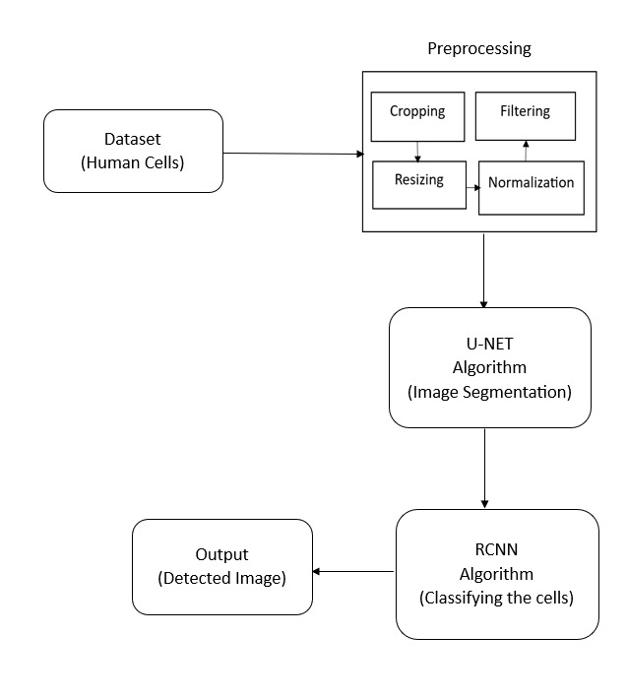
Block Diagram

Slide 9
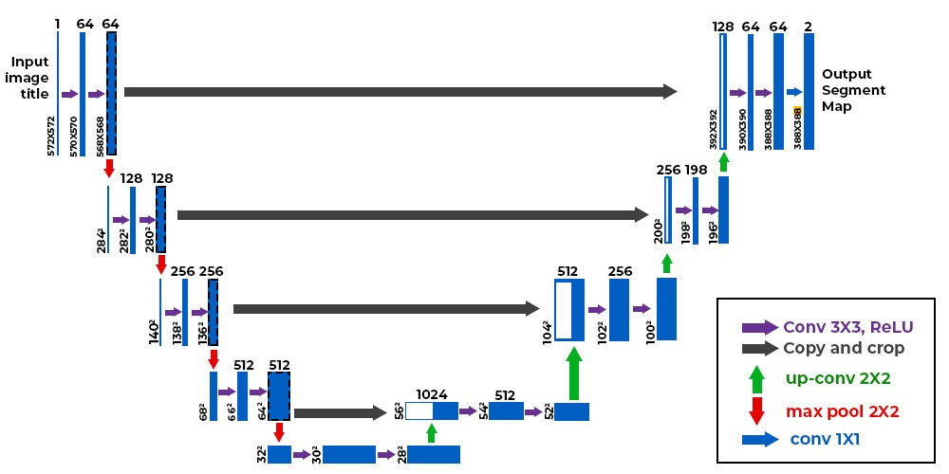
U-Net Architecture

Slide 10
Workflow Of The Project
Data Collection and Preprocessing:
Gather high-quality microscopic cell images from reliable medical databases.
Enhance image quality using preprocessing techniques such as normalization, resizing, and renaming.
Cell Segmentation with U-Net:
Utilize the U-Net model to separate cells from the background.
Generate precise segmentation masks to highlight regions of interest.
Feature Extraction:
Extract key morphological features such as shape, size, and texture from segmented cells.
Organize the extracted data for further classification.

Slide 11
Classification using RCNN:
Apply a Region-Based Convolutional Neural Network (RCNN) to categorize cells.
Differentiate between normal and abnormal cells based on extracted features.
Output Generation and Analysis:
Display segmented images along with classification results.
It provides diagnostic insights to assist medical professionals in decision-making.

Slide 12
Dataset
VGG (Synthetic Bacteria) Dataset:
Consists of 200 synthetic images (256×256 pixels) with an average of 174±64 cells per image. These images simulate bacterial cells with features like overlap, shape variability, defocus blur, and halo effects, closely resembling real-world microscopy images.
MBM (Modified Bone Marrow) Dataset:
Contains 44 hematoxylin-eosin-stained images (600×600 pixels) from 8 patients, averaging 126±33 cells per image. It features uneven backgrounds and varied cell shapes, posing challenges for automated cell counting.
ADI (Human Adipose Tissue) Dataset:
Comprises 200 images (150×150 pixels) of human subcutaneous adipocytes with high morphological diversity and an average of 165±44 cells per image, challenging automated counting.

Slide 13
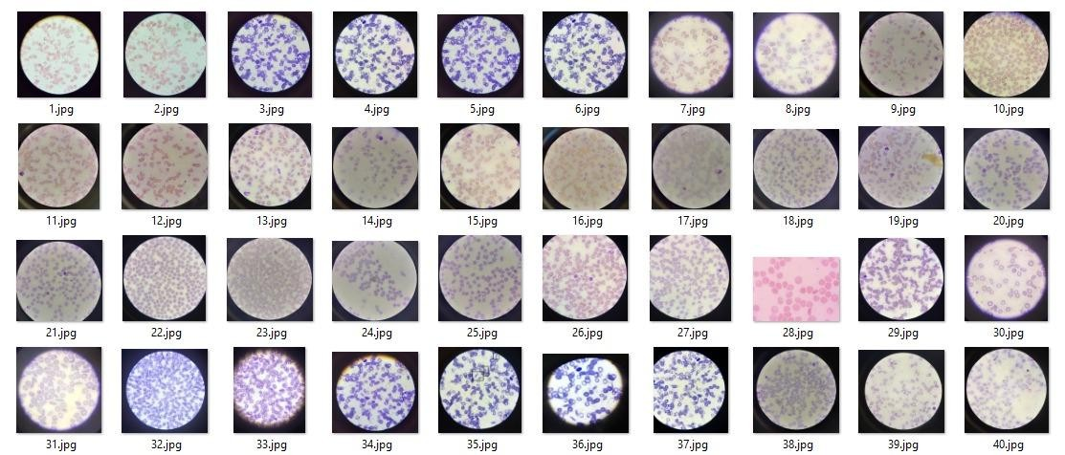
Sample Dataset

Slide 14
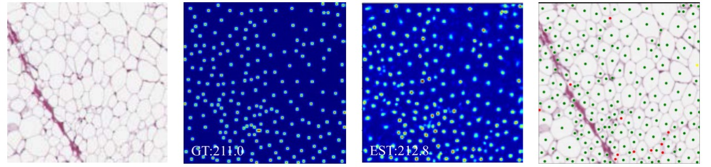
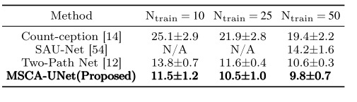
Sample ADI dataset
Groundtruth Density Map
Predictive Density map
Input Image
Cell Detection
Result on ADI Dataset :

Slide 15
Conclusion
In medical diagnostics, human cell analysis is essential for early illness identification and efficient treatment planning. This research offers an automated method that combines RCNN for accurate cell classification with U-Net for accurate image segmentation. The system improves cell identification efficiency, minimises errors, and decreases manual labour by automating the segmentation and classification process. The suggested approach helps medical practitioners make quicker and more accurate diagnostic choices and has important applications in pathology, biomedical research, and automated illness detection. This method has the potential to completely transform medical diagnostics and help detect diseases more quickly and accurately with additional advancements and practical use.

Slide 16
Reference
Wei Qian, Dingcheng Tian, Yaqi Zhu, “MSCA-UNet: Multi-Scale Convolutional Attention UNet for Automatic Cell Counting Using Density Regression”,China, 26 July, 2024
2022 44th Annual International Conference of the IEEE Engineering in Medicine & Biology Society (EMBC) Scottish Event Campus, Glasgow, UK, July 11-15, 2022
X. Sun, J. Gu, and H. Sun, ‘‘Research progress of zero-shot learning,’’ Int. J. Speech Technol., vol. 51, no. 6, pp. 3600–3614, Jun. 2022.
S. Hyontai, ‘‘Performance of machine learning algorithms and diversity in data,’’ in Proc. MATEC Web Conf., vol. 210, 2020

